Slide 1
Modern Fishing Principles, Techniques & Tools

Slide 2
List of contents
Principles
4 ways of fishing
Commonly used tools

Slide 3
The definition of Modern Fishing
Study what you want to study on classes or “fantastic” meetings & lectures.

Slide 4
The fundamental principle of Fishing
Teachers haven’t got infinite eyes.
So teachers’ attention is limited.
So you can FISH whenever your teacher is not looking @ you.

Slide 5
Teachers haven’t got infinite eyes.
----FISHER_’s first law

Slide 6
Teachers’ attention is limited.
----FISHER_’s second law

Slide 7
So you can FISH whenever your teacher is not looking @ you.
----The Lemma of FISHER_’s second law

Slide 8
4 different ways of FISHING
Method 1: note faking.
Method 2: the invisibility curse.
Method 3: Analyze teacher’s route.
Method 4: follow a real FISHER.

Slide 9
Method 1: note faking
You can pretend to take notes while actually writing something other.
This method is very suitable on the Geography classes and this class.

Slide 10
Method 2: the invisibility curse
Certainly, you can make a curse on someone who is stopping you from FISHING.
This curse is known as the invisibility curse.
Such method is often used by FISHER_ itself.
It cannot be used on Geography Classes
This method is not practical for me.

Slide 11
Method 3: Analyze teacher’s route
As far as your teacher is not random walking. You will surely find a regular pattern that how your teacher moves.
This is known as the Route Analyzing Technology.

Slide 12
Let me show you our research:

Slide 13
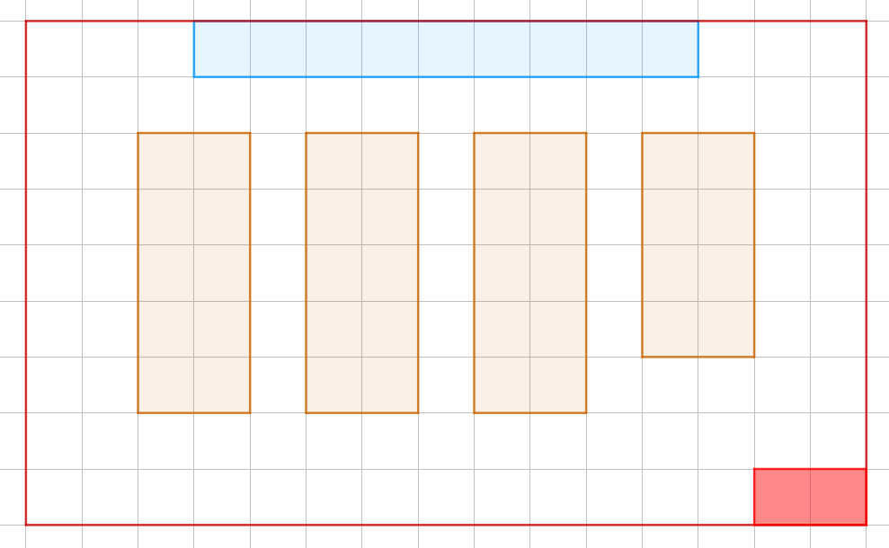
Classroom

Slide 14
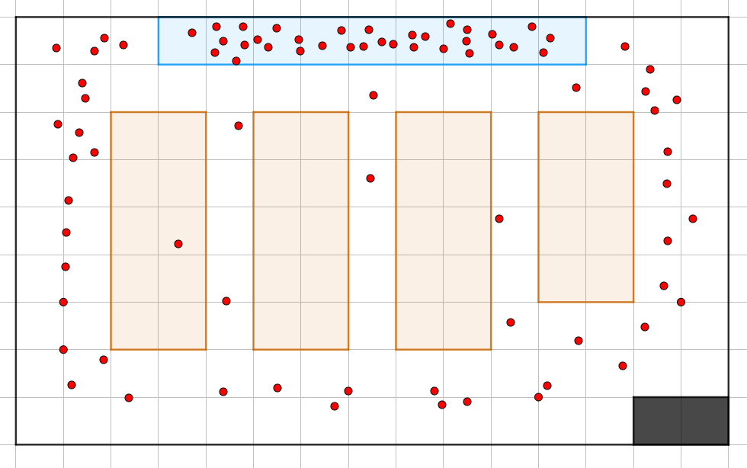
Math Class

Slide 15
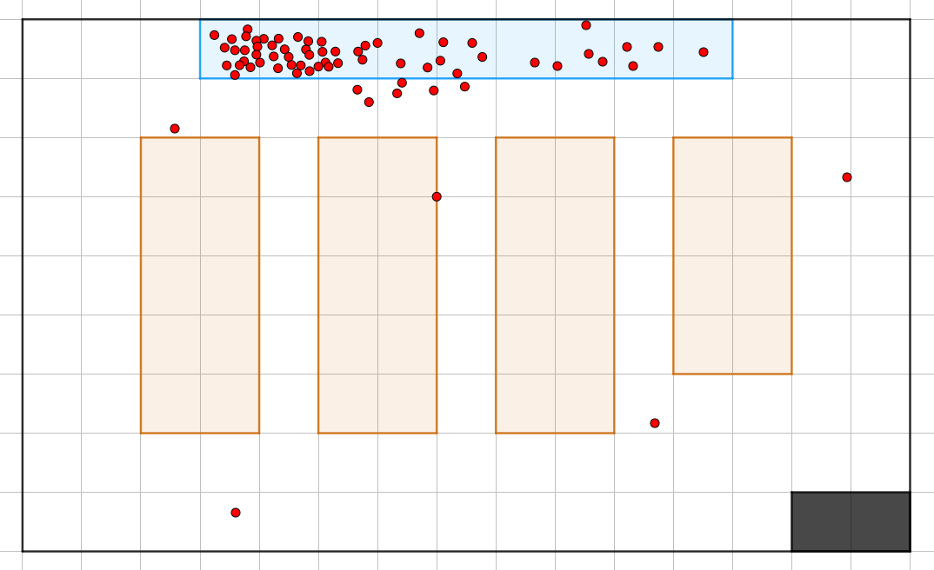
English Class

Slide 16
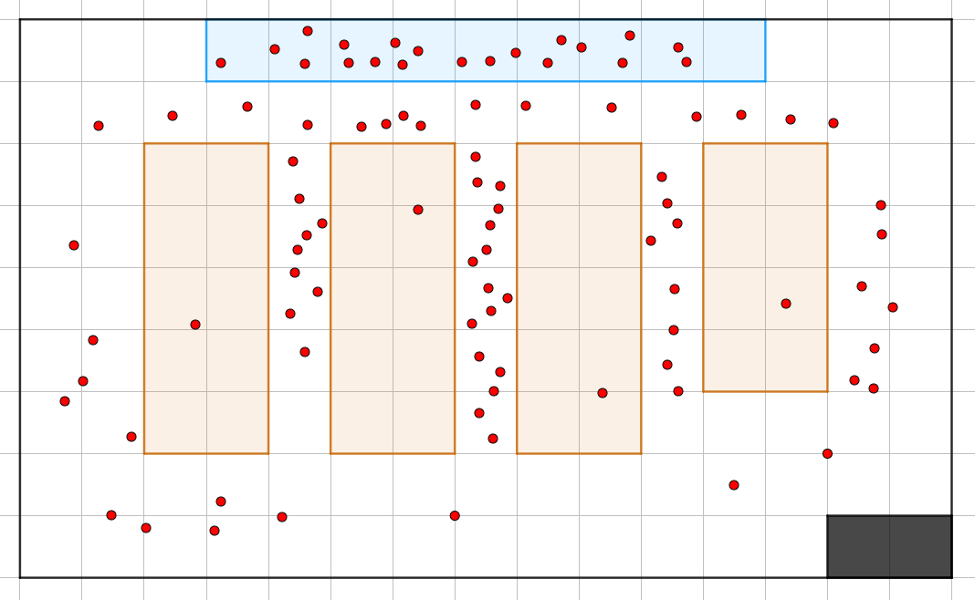
Geography Class

Slide 17
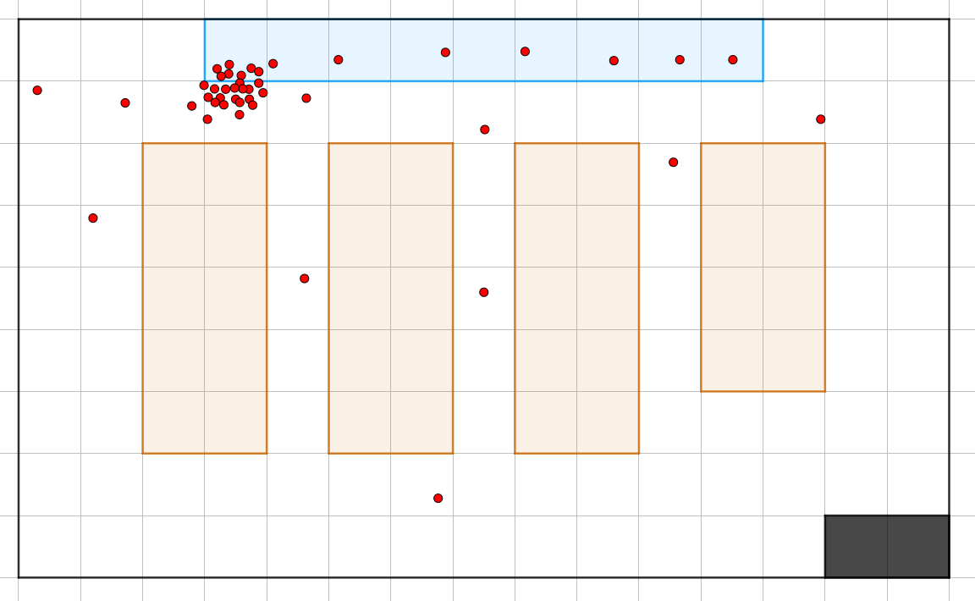
Art Class

Slide 18
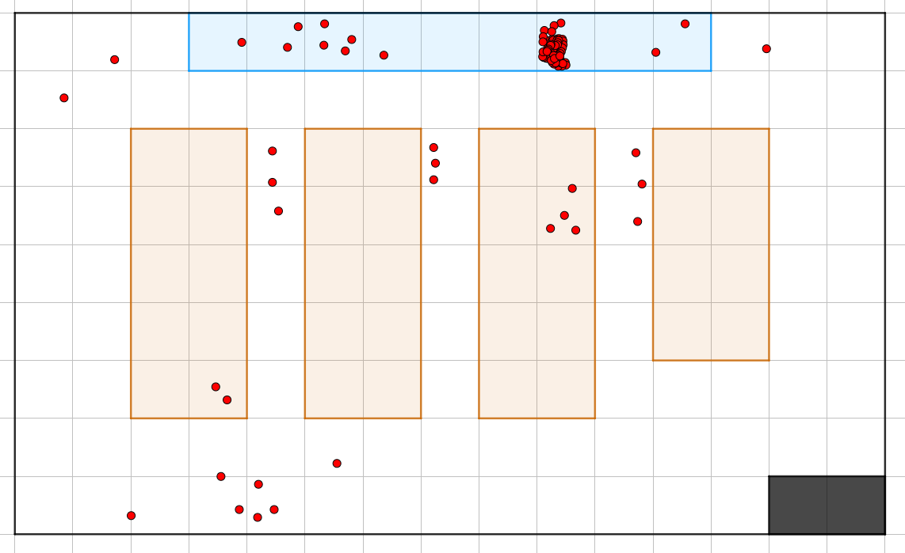
Music Class

Slide 19
How Chinese homework is checked?

Slide 20
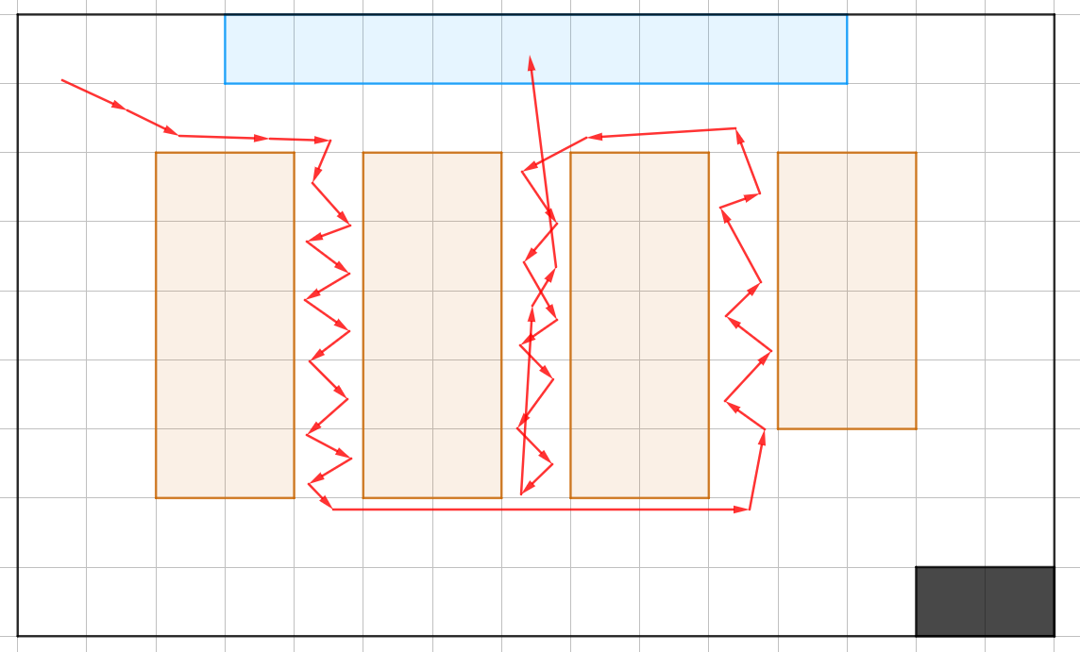

Slide 21
Method 4: follow a real FISHER
If you don’t think you have enough skill on FISHING, you can follow someone who has better skill.
P.S. No. 34 is a really a good selection.

Slide 22
Tools
FISHING is not something requires a lot of tools. It usually only needs one of the follow:
A pen or pencil.
A book or a piece homework.
A empty paper.
A notebook for note faking.

Slide 23
Death Warning
NEVER DO FISHING ON PHYSICS CLASSES!
Or else you might be hit by the Moon.

Slide 24
The end.

Slide 25
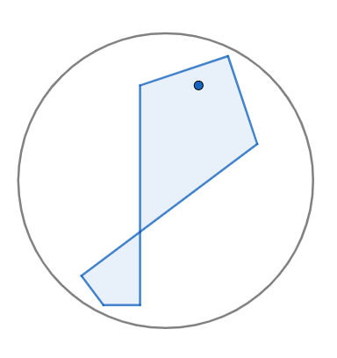
The new FISHING organization is here!

